Slide 1
SECURE THE USER SESSION FROM COOKIE HIJACKING
NAME: MUHAMMAD AMINUDDIN BIN
RAMLI
MATRIC ID: CA20142

Slide 2
CHAPTER 1
INTRODUCTION

Slide 3
INTRODUCTION
Increasing Dependence on Web Applications
Vulnerability of Cookies
Risk Associated with Cookie Hijacking
Purpose of this project to develop an Effective Technique to Prevent Cookie Hijacking
Exploring Cookie Hijacking Attacks
Contribution to a Secure Internet Environment.

Slide 4
1.2
PROBLEM STATEMENT

Slide 5
PROBLEM STATEMENT
Vulnerability of Ecommerce Websites
Impersonation and Malicious Actions
Insufficient Prevention and Detection Measures
Need for a Comprehensive and Proactive Approach

Slide 6
1.3
OBJECTIVES

Slide 7
OBJECTIVES
To assess the effectiveness of web browser security features such as HttpOnly and Secure flags in preventing cookie hijacking attacks in Amin Sports Online system.
To develop new techniques or enhance the existing methods for preventing cookie hijacking attack in Amin Sports Online system.
To assess the impact of cookie hijacking attacks on user privacy and security in Amin Sports Online system.

Slide 8
1.4
SCOPE

Slide 9
SCOPE
USER SCOPE
SYSTEM SCOPE
DEVELOPMENT SCOPE
Administrator
Customers
Developer
User Interface (UI)
Database
Security
Tools to develop the website system
Database server
Cookie Hijacking Simulation Tool

Slide 10
CHAPTER 2
LITERATURE REVIEW

Slide 11
COMPARISON OF EXISTING SIMULATION TOOLS
OWASP
BURP SUITE
BeEF FRAMEWORK
OWASP ZED ATTACK PROXY (ZAP)
Intercept and modifying the HTTP request that has the cookies
Acts as an intercepting proxy between the web browser and web application that is being tested.
Using intruder tool, can perform brute force on login page or password reset page.
Enable attacker to use a target’s browser as the attack point.
For cookie hijacking, depends on the configuration

Slide 12
COMPARISON OF EXISTING PREVENTION FROM COOKIE HIJACKING ATTACKS
HTTPS
HTTPONLY COOKIE
SAMESITE COOKIES
STRENGTHS
Can protect from man-in-the-middle-attacks
Encrypt the communication between client and server
Supported by most browsers
WEAKNESSES
Implementation can be challenging
Can impact the performance of the website
Can be exposed to CSRF attacks
STRENGTHS
Easy to implement
Prevent client-side from access cookies
Supported by most browsers
WEAKNESSES
Do not protect against all attacks
Can be bypassed by advanced attacker
STRENGTHS
Easy to implement
Restrict how the cookies are sent in cross-origin requests
Supported by most browsers
WEAKNESSES
May break functionality on web that rely on embedded content from third-party websites.
May not supported by older browsers

Slide 13
CHAPTER 3
METHODOLOGY

Slide 14
RAPID APPLICATION DEVELOPMENT (RAD)
Requirement Planning Phase
Collaboration with Stakeholders
Focus on Security Requirements.
Requirement Documentation
Ensuring Secure Cookie Implementation
Implementing HtppOnly Cookies

Slide 15
RAPID APPLICATION DEVELOPMENT (RAD)
System Design Phase
Design the system by ensuring the implementation of security measures
Design the database that involved encryption of the sensitive data.
Development Phase
Prototyping and feedback
Programming Language
Database Server
Secure Coding Practices
Security Testing

Slide 16
RAPID APPLICATION DEVELOPMENT (RAD)
Cutover Phase
System Deployment
Secure Configuration
System Testing
User Training

Slide 17
3.2
PROJECT REQUIREMENTS

Slide 18
FUNCTIONAL REQUIREMENTS
Secure cookie transmission.
Logging and monitoring.
Vulnerability assessment and testing.

Slide 19
NON-FUNCTIONAL REQUIREMENTS
Security
Performance
Reliability
Usability

Slide 20
CONSTRAINTS & LIMITATIONS
Complexity
Compatibility

Slide 21
3.3
PROPOSED DESIGN

Slide 22
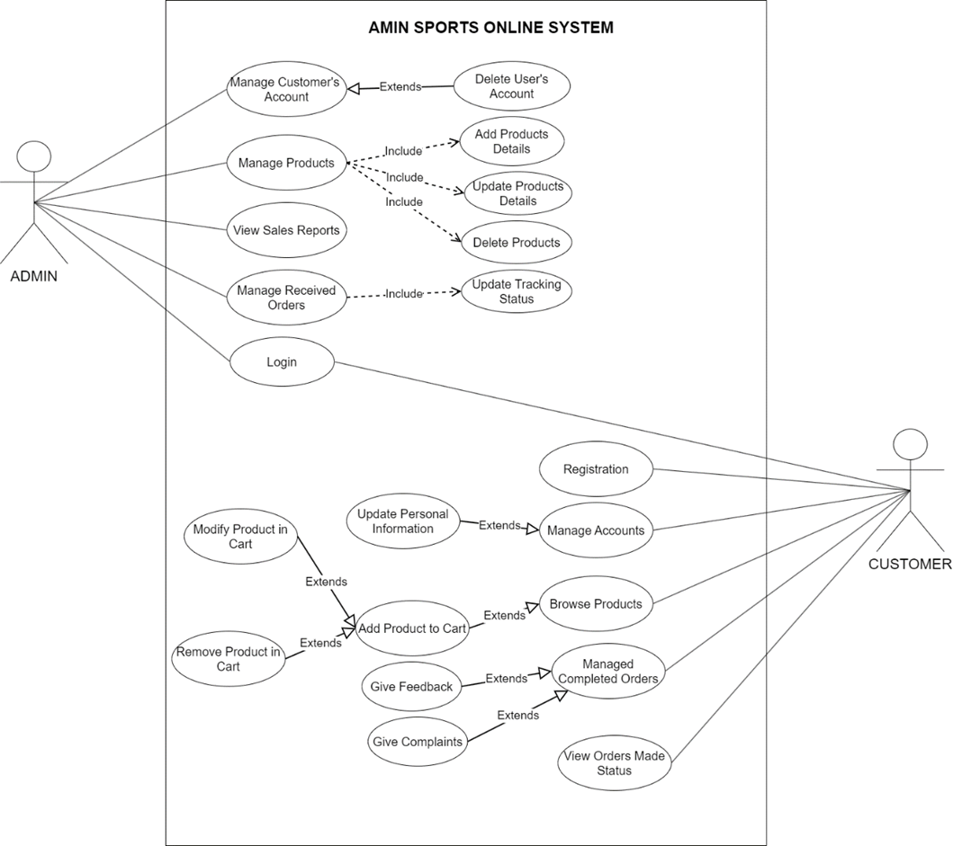
USE CASE DIAGRAM

Slide 23
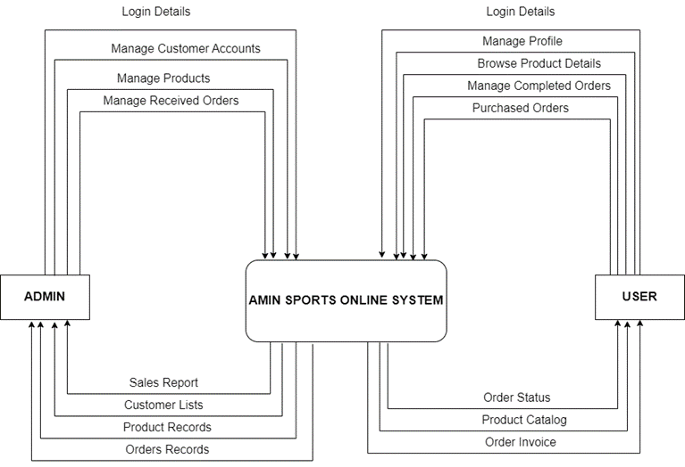
CONTEXT DIAGRAM

Slide 24
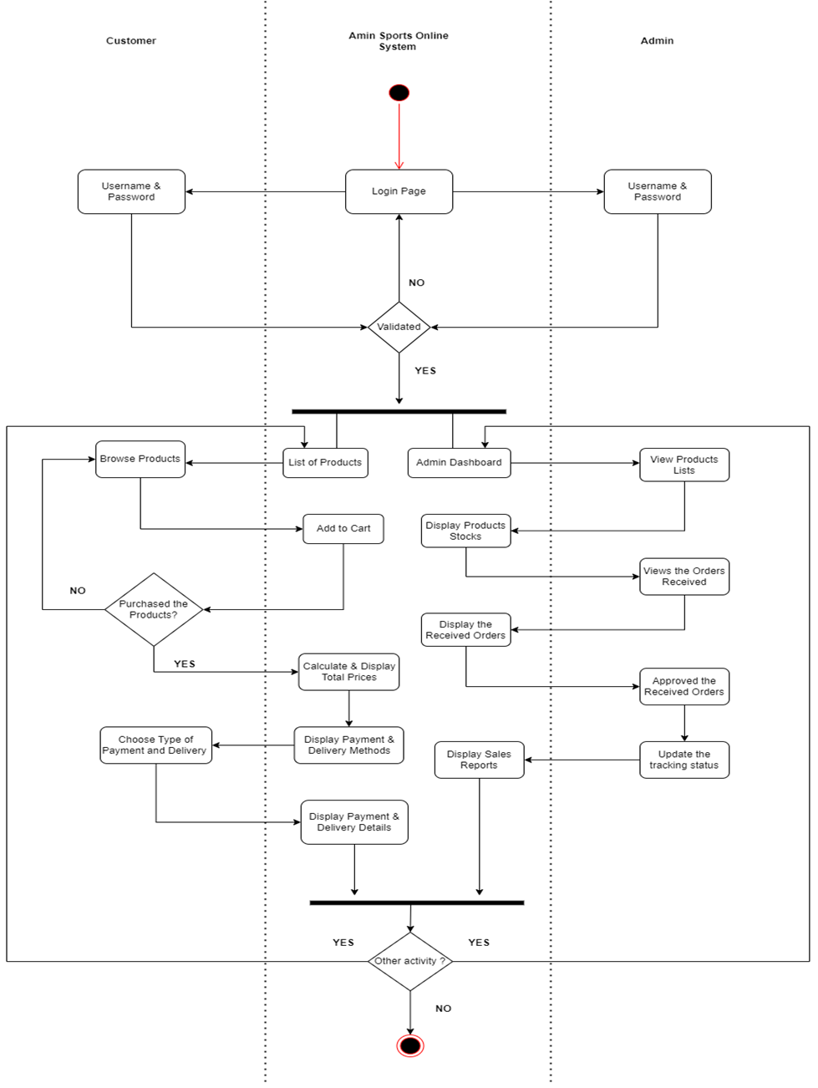
ACTIVITY DIAGRAM

Slide 25
3.4
DATA DESIGN

Slide 26
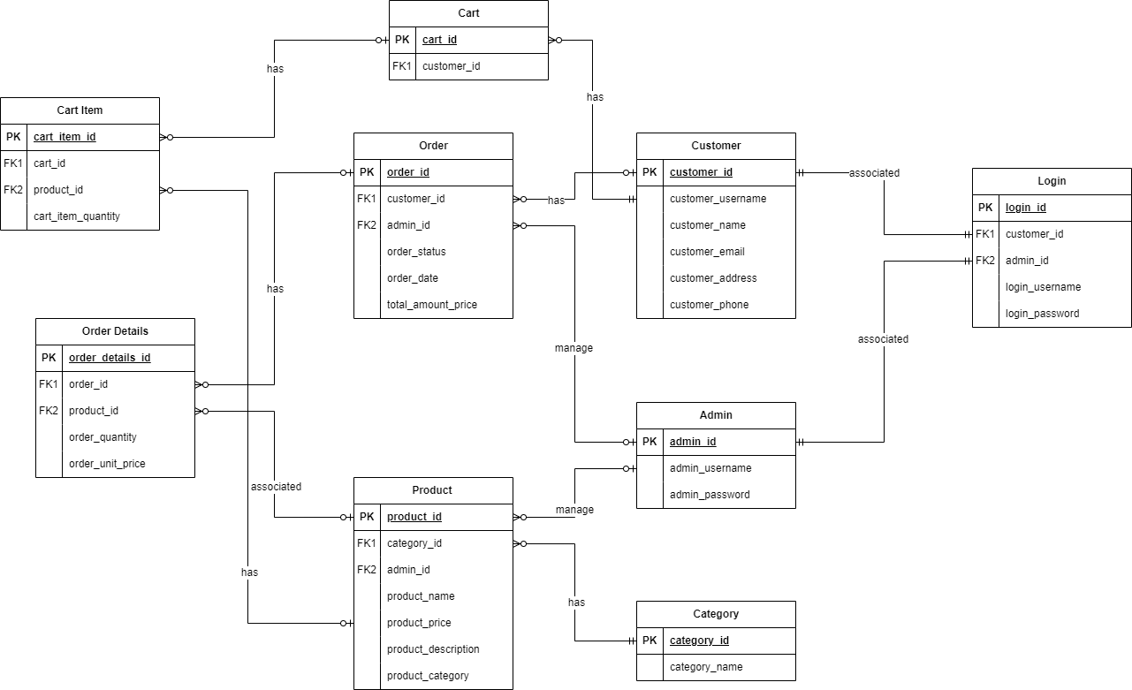
ENTITY RELATIONSHIP DIAGRAM (ERD)

Slide 27
3.5
TESTING PLAN

Slide 28
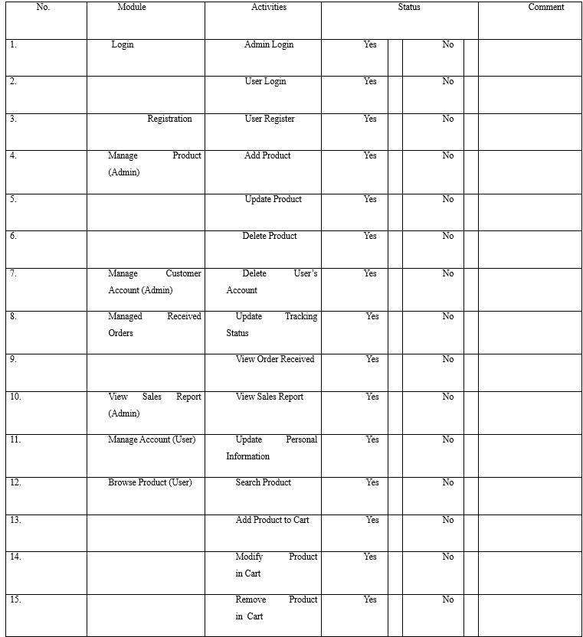
TESTING PLAN
USER ACCEPTANCE TEST SAMPLE

Slide 29
3.6
POTENTIAL USED OF PROPOSED SOLUTION

Slide 30
BENEFITS OF THE PROPOSED SOLUTION
Protection of User Login Credentials
Increased User Confidence
Trustworthy and Secure Platform

Slide 31
3.7
REFERENCES

Slide 32
Smith, J. (2022, March 15). What Are Cookies? How They Work and Why They Matter. How-To Geek. Retrieved April 30, 2023, from https://www.howtogeek.com/241006/what-are-cookies-and-why-are-they-important/
OWASP. (2021). Cross-Site Request Forgery (CSRF). Retrieved April 30, 2023, from https://owasp.org/www-community/attacks/csrf
OWASP. (2021). Cross-Site Request Forgery (CSRF) Prevention Cheat Sheet. Retrieved April 30, 2023, from https://cheatsheetseries.owasp.org/cheatsheets/Cross-Site_Request_Forgery_Prevention_Cheat_Sheet.html
Nidecki, T. A. (2020). Session Hijacking and Other Session Attacks. Acunetix. Retrieved April 30, 2023, from https://www.acunetix.com/blog/articles/session-hijacking/
Vojtko, M. (2020, November 16). The Ultimate Guide to Session Hijacking aka Cookie Hijacking. Hashed Out by the SSL StoreTM. Retrieved April 30, 2023, from https://www.thesslstore.com/blog/the-ultimate-guide-to-session-hijacking-aka-cookie-hijacking/

Slide 33
Chandel, R. (2017, July 6). Beginner Guide to understand cookies and session management. Hacking Articles. https://www.hackingarticles.in/beginner-guide-understand-cookies-session-management/
Wear, Dr. S. (n.d.). Web security testing with BURP suite. Pluralsight. https://www.pluralsight.com/paths/web-security-testing-with-burp-suite
Moyle, E. (2023, February 1). How to use beef, the Browser Exploitation Framework: TechTarget. Security. https://www.techtarget.com/searchsecurity/tutorial/How-to-use-BeEF-the-Browser-Exploitation-Framework
Team, SSL. com S. (2021, October 13). What is HTTPS?. SSL.com. https://www.ssl.com/faqs/what-is-https/
Merewood, R. (2019, May 7). Samesite Cookies explained. web.dev. https://web.dev/samesite-cookies-explained/

Slide 34
Prototype Link:
https://www.figma.com/file/nxDrUPZmnRLMf3AYtR6jUr/PSM-1-PROTOTYPE?type=design&node-id=0%3A1&t=3keijiz43Ub5Okt7-1

